Slide 1
Heart bleed attack extended with Session and Account Hijacking

Slide 2
What is Heartbleed Attack ?
The Heartbleed Bug is a serious vulnerability in OpenSSL cryptographic software library.
The Heartbleed bug allows anyone on the Internet to read the memory of the systems protected by the vulnerable versions of the OpenSSL software.
It allows to steal the information protected, under normal conditions, by the SSL/TLS encryption used to secure the Internet.
This compromises the secret keys used to identify the service providers and to encrypt the traffic, the names and passwords of the users and the actual content.

Slide 3
What are the affected websites ?
Tumblr
Google
Yahoo
Intuit (makers of TurboTax)
Dropbox
Netflix
Facebook

Slide 4
What is SSL and Open SSL ?
SSL
short for Secure Sockets Layer, is a family of encryption technologies that allow web users to protect the privacy of information they transmit over the internet.
SSL accomplishes that by transforming your data into a coded message that only the recipient knows how to decipher. If a malicious party is listening to the conversation, it will only see a seemingly random string of characters, not the contents of your emails etc.
Open SSL
It is a software that allows computers to communicate using the SSL encryption standards.

Slide 5
Status of the SSL Versions
•OpenSSL 1.0.1 through 1.0.1f (inclusive) are vulnerable
•OpenSSL 1.0.1g is NOT vulnerable
•OpenSSL 1.0.0 branch is NOT vulnerable
•OpenSSL 0.9.8 branch is NOT vulnerable

Slide 6
The SSL standard includes a heartbeat option, which allows a computer at one end of an SSL connection to send a short message to verify that the other computer is still online and get a response back.
Heartbeat message has three parts:
A request for acknowledgement
A short, randomly chosen message
The number of characters in that message.

Slide 7


How does this attack work ?
In heartbleed attack the attackers create a malicious message that helps to tricks the computer at the other end into divulging secret information. A vulnerable computer can be tricked into transmitting the contents of the server’s RAM.
Notes:
The Heartbleed vulnerability arose because OpenSSL's implementation of the heartbeat functionality was missing a crucial safeguard: the computer that received the heartbeat request never checked to make sure the request was actually as long as it claimed to be. So if a request said it was 40 KB long but was actually only 20 KB, the receiving computer would set aside 40 KB of memory buffer, then store the 20 KB it actually received, then send back that 20 KB plus whatever happened to be in the next 20 KB of memory. That extra 20 KB of data is information that the attacker has now extracted from the web server.

Slide 8
Session Hijacking
Is an attack where a user session is taken over by an attacker.
A session starts when you log into a service, for example your banking application, and ends when you log out. The attack relies on the attacker’s knowledge of your session cookie, so it is also called cookie hijacking or cookie side-jacking.

Slide 9
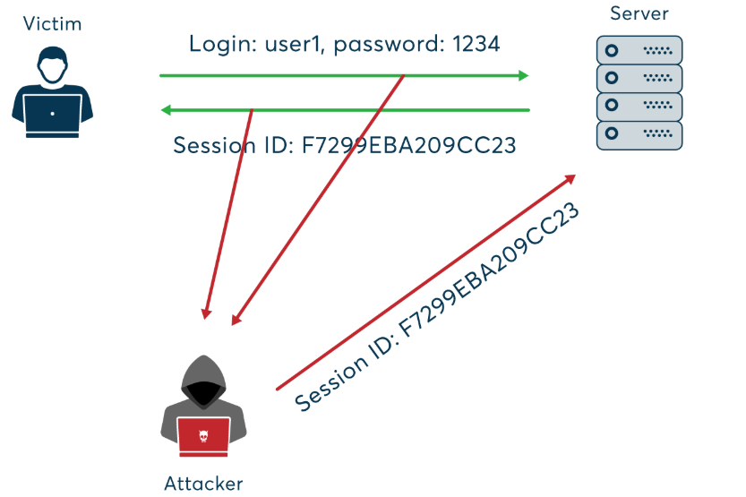
How does this attack happen ?
To perform session hijacking, an attacker needs to know the victim’s session ID (session key).
This can be obtained by stealing the session cookie or persuading the user to click a malicious link containing a prepared session ID.
In both cases, after the user is authenticated on the server, the attacker can take over (hijack) the session by using the same session ID for their own browser session.
The server is then fooled into treating the attacker’s connection as the original user’s valid session.

Slide 10
Account Hijacking
Is a process through which an individual’s email account, computer account or any other account associated with a computing device or service is stolen or hijacked by a hacker.
Account hijacking is carried out through phishing, sending spoofed emails to the user, password guessing or several other hacking tactics.

Slide 11
Demonstration

Slide 12
Tools Used
Bee Box
Kali Machine
Burpsuite
Nmap –
( Network Mapper, is an open source Linux command line tool for network exploration and security auditing. With Nmap, server administrators can quickly reveal hosts and services, search for security issues, and scan for open ports.
The Nmap tool can audit and discover local and remote open ports, as well as network information and hosts. )

Slide 13


Heart bleed attack extended with Session and Account Hijacking

Slide 14
Thank You

